Slide 1
Microsoft Excel Accessibility for AccessU 2022
How to Create Excel Files that Can Be Read by All People

Slide 2

About Me
Richard U Steinberg
rsteinberg@austinchronicle.com
richard.steinberg@wellsfargo.com
Notes:
Mr. Smarty Pants Knows since 1988 and Senior Accessible User Experience Specialist since 2017
Got into accessibility in 2006 after writing a story for the Chronicle on how Yellow Cab of Austin was hiring blind dispatchers and had to make sure their software worked with the JAWS screen reader. Texas law changed that year that required state agency websites to be Section 508 compliant. So I’ve been at it for about 16 years.
https://www.austinchronicle.com/news/2006-06-09/373276/

Slide 3
Overview
Introduction to Accessibility
9 Basic Requirements for Excel
Let’s talk a little about Excel forms
Tips for All MS Office Apps

Slide 4


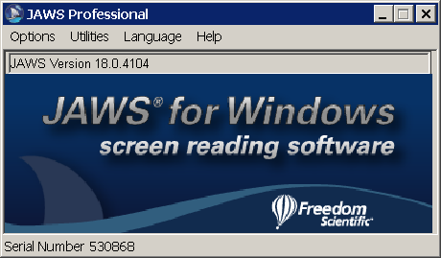
Introduction to Accessibility
Notes:
Microsoft Office provides more tools than ever to improve accessibility. Unfortunately, a “make accessible” button does not exist on our computers, so it’s necessary for us to know how to create accessible documents on our own.
Most of us are self-taught on Microsoft Office—me included—and none of that self-training included learning how to use all of its built-in tools. If you want to learn how to make Word, Excel, and PowerPoint files that are accessible documents, you may need to rethink how you use these programs—it depends on what tools you are already familiar with.
There are many kinds of technologies to help people with disabilities. Screen readers are a type of software that takes what is on a screen and reads it out loud. Some common screen readers include JAWS, NVDA and on the Macintosh and iPhone there’s VoiceOver.
We could have an entire presentation on how to work with a screen reader, but that’s not necessary to learn how screen reader users interact with their computers. If people can’t see, they can’t do a quick visual scan of a page to find items that might be of interest, or to skip items that are unnecessary. Also, they can’t use a mouse they can’t see where it is pointing. A screen reader user will probably be using a keyboard to navigate, but it’s not the same way as a sighted person would navigate. Think of a table of contents in a book or newspaper—you go to the place that you want to go to. You wouldn’t expect to have to read the whole newspaper to get to the sports section—you’d want to jump right to it or skip passed it. That is how screen reader users interact with a document.

Slide 5
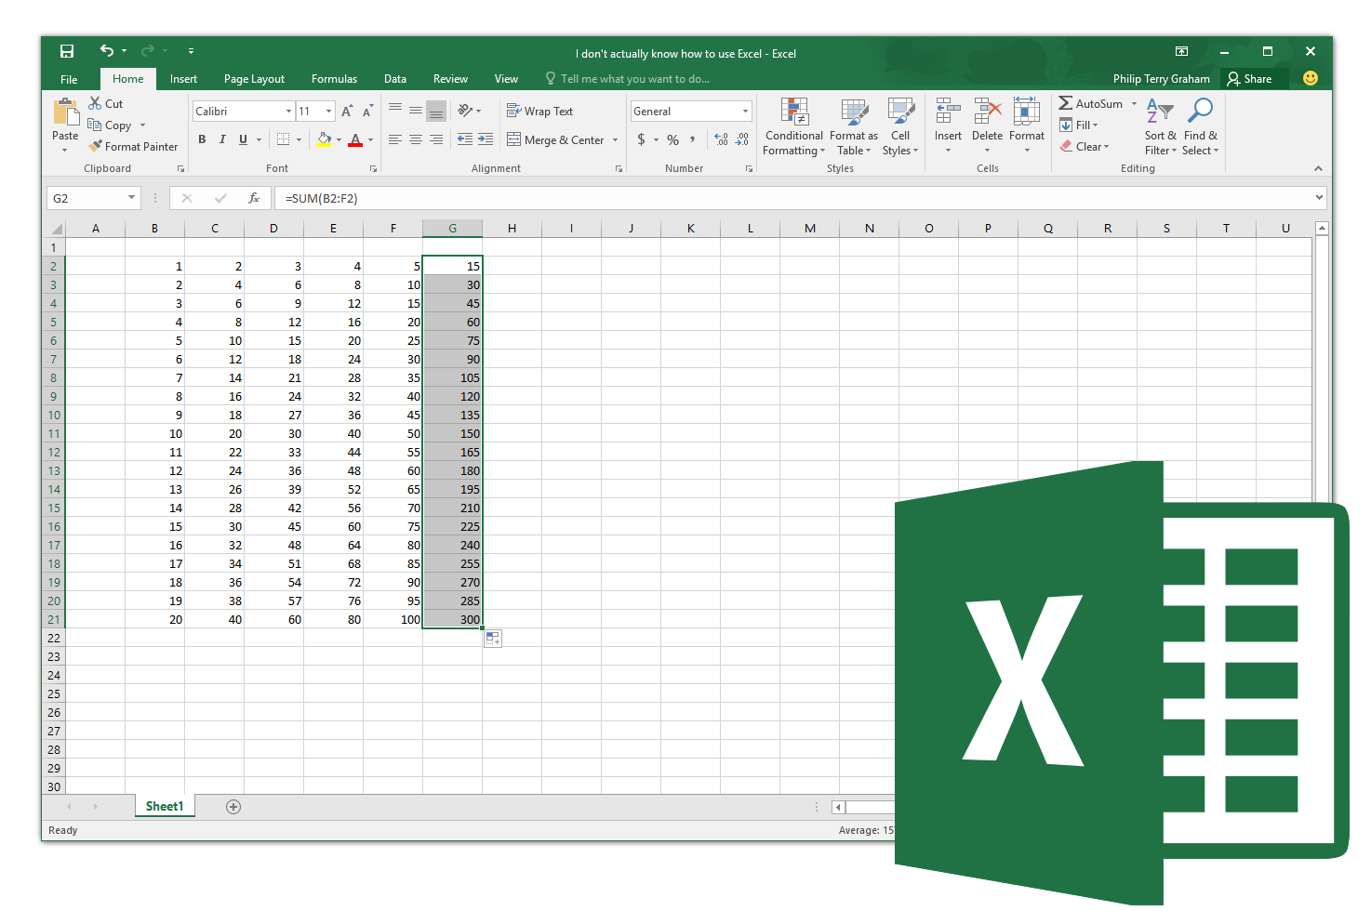
9 Basic Requirements for Excel
Start in A1
Stay in the Grid
No Blank Rows, Columns, Data Cells, and Hide Unused
No Merged or Split Cells in Data Portion
Worksheet Names and Table Titles; No Blank Worksheets
Row and Column Headers
Alternative Text
End of Worksheet, Workbook
Before Saving
Notes:
There are 9 basic requirements to make sure an Excel file is accessible for screen reader users. There are even more requirements if your Excel file is used as a form for people to complete.

Slide 6
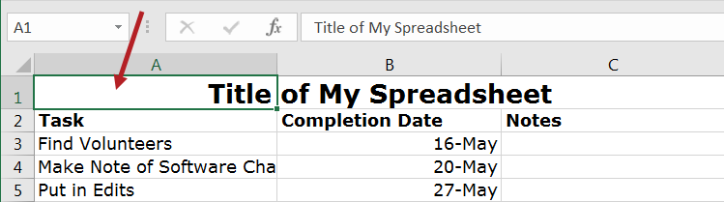
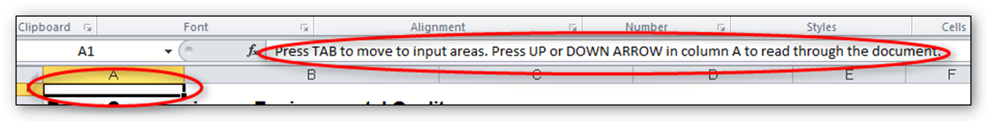
1. Start in A1
Notes:
There are several tips dealing with the A1 cell. A screen reader starts reading any sheet in cell A1. If you have a table on the sheet, A1 may simply be the title for the table. In a few minutes I will explain why it’s important to not leave A1 blank.
If the sheet is long or complex, add instructions or an overview in A1. When visual users first open a spreadsheet, they get an immediate sense of what is on the sheet. Having a short sentence or two in A1 will give screen reader users the same quick overview. The text can say “This sheet contains 3 data tables” or “This sheet contains one chart and 2 tables” or “This sheet has 1 long table with 500 rows grouped by department.”
You can make this text fairly small, or even change the color to match the background color. This way it will not show up visually, but will still be read by the screen reader.

Slide 7
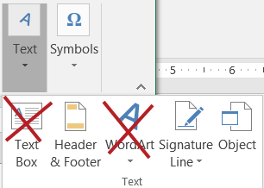
2. Stay in the Grid
Notes:
Information located in the grid of worksheet cells is accessible to a screen reader user in the correct reading order. Information floating on top of the grid of cells, such as text boxes, charts, and images, is not accessible in the correct reading order.
Floating content such as text boxes, charts, and images will be announced as “Embedded objects” when a sheet is first opened with a screen reader. If the object has alt text, it can be read by a screen reader, but the screen reader cannot tell where in the grid the object is located or what it may refer to in the grid.
Instead of a text box, put text in a cell. You will have to design the worksheet so that the text will be read in a reasonable order with respect to the other information it refers to.
For images and charts, the alt text will have to explain the relationship of the image or chart to the other information on the sheet. I will explain about alternative text later in this training. It works for images, but not for charts, but there is a workaround. The alt text could say something like “Chart from Data on the Worksheet named _______”

Slide 8
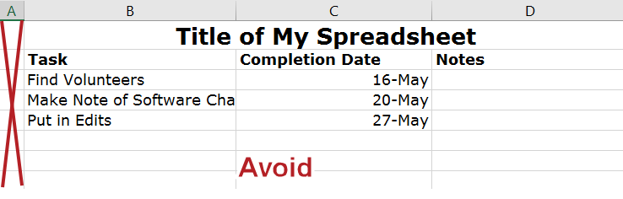
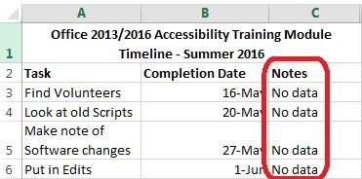
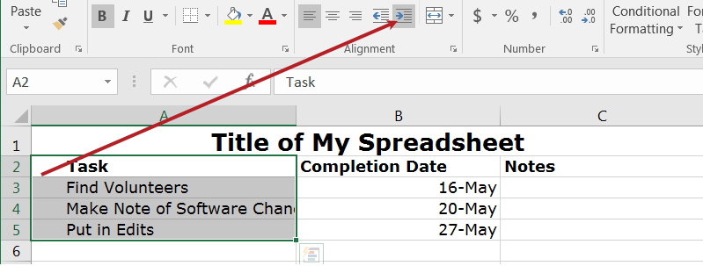
3. No Blank Rows, Columns, Data Cells
Indent text instead of inserting an empty column
Notes:
Avoid Blank Rows and Columns Within a Table
Resize your rows and columns to give them spacing that helps make the table readable rather than using blanks to create your spacing. One really common mistake is leaving column A blank to look like a margin.
Also, if you have two or more tables on the same worksheet, leave a single blank row between each table. You can resize the blank row to create a space that is visually appealing.
In addition, cells should not be left blank. If the cell really has no data, then you can put in: “This cell intentionally left blank” or “No data.” You can make the text visually hidden by coloring the font the same color as background color.

Slide 9
Hide Unused Rows and Columns
Indent text instead of inserting an empty column
Notes:
To hide columns:
Select the first blank column to the right of your data. Holding down Shift and CTRL keys, press the right arrow key.
Right-click in the selected area and choose Hide.
To hide rows:
Leave one blank row below your data, then select the next row below that. Holding down Shift and CTRL, press the down arrow key.
Right-click in the selected area and choose Hide.

Slide 10
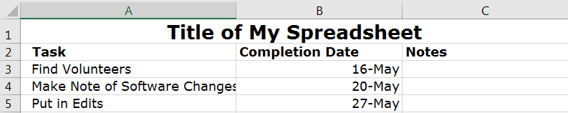
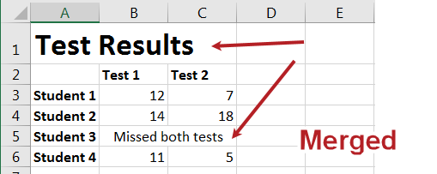
4. No Merged or Split Cells in Data Portion
Notes:
Merged cells in the data portion will be difficult for screen reader users to understand. It is OK to have them in the title portions of tables, but not in the data portion.

Slide 11
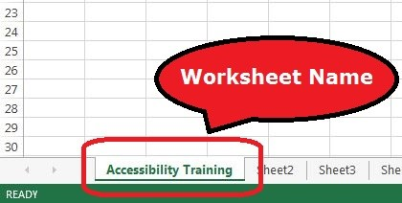
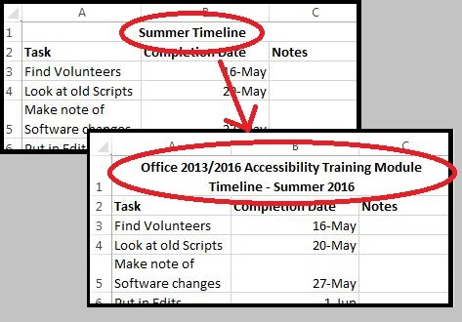
5. Worksheet Names, Table Titles, Blank Worksheets
Notes:
Provide a descriptive name for each worksheet in your workbook, and a descriptive title for each area of your worksheet that is formatted as a table.
To change the name of a worksheet, double-click on the name in the tab at the bottom and type in a new name. Worksheet names must be between one and 31 characters long. The special characters colon, slash, backslash, question mark, asterisk, and left and right square brackets are not allowed.
Give each table a descriptive title that explains what information it contains. The title should be in one or more rows directly above the table, and should start in column A. For example, instead of the title, “Summer Timeline,” use a title that will tell the reader five years from now what the table is about, such as, “Office 2013/2016 Accessibility Training Module Timeline, Summer 2016.”

Slide 12
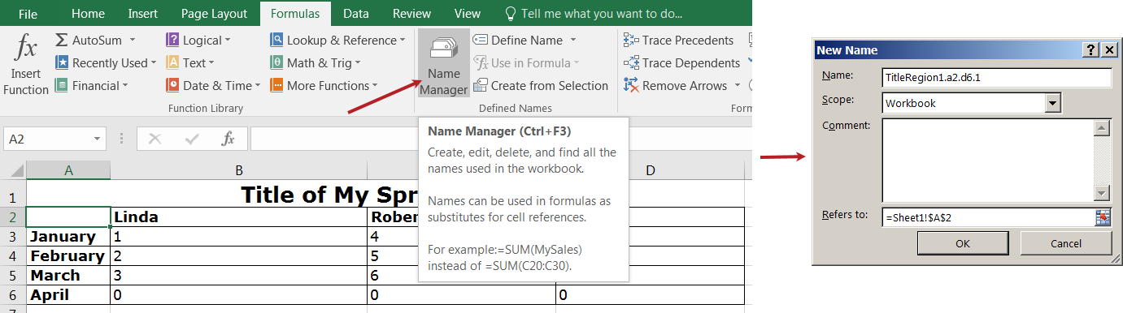
6. Row and Column Headers
Notes:
Each table should have row and column headers for every column and every row in a way that makes sense. Don’t leave any headers blank, even if the meaning seems obvious to you. Column headers should occupy just one row if possible.
This is the most complicated part of making a table accessible in Excel, but it helps screen reader users know which cells represent the headers of your table. It involves defining the “Title Region” which is a little bit of code that lets the screen reader know to repeat the row and column titles when reading the data.
First, a little about how a screen reader reads a table. The default for a screen reader in English is to read starting at the top, and going left to right. When it gets to the end of a line, it goes to the next line down and reads, again, from left to right.
What we want is the screen reader to repeat the column header each time before it reads the value.
Before we get going, we need to know three things about our table:
Is this the first (or only) table on this worksheet?
What are the cells for the top left and bottom right cells in your table?
Is this worksheet the first (or only) worksheet in this workbook?
Here’s how we do it:
To get started, select the top-left cell in your table. Don’t count the titles, but you do count all row and column headers as part of your table. In this example, start in A2
Go to the Formulas tab in the Ribbon, and choose Name Manager in the Defined Names group. Choose New in the top left corner. A new dialog box opens. In the Name field, we are going to type a fairly complicated name.
Type TitleRegion then put a 1 if this is the first table on your worksheet; then a period; then the range of cells in your table from top left to bottom right (with a period in between); then another period; then the worksheet number. So in this case our Title code looks like this: TitleRegion1.a2.d6.1
You can ignore all other fields in this dialog box. Click OK and Close.
That’s it! You’ve just given JAWS the instructions for how to properly read the table so the listener can easily understand it and associate the column and row headers with the data cells.
If your table only has one column header, define a ColumnTitleRegion instead of a TitleRegion. If your table only has one row header, define a RowTitleRegion. The rest of the coding is the same.
Finally, if you create these titles and then make a simple change, such as moving your worksheet tabs around or adding an extra row, you’ll have to recode the titles to match your spreadsheet’s new reality. So save this step for when you are ready to publish.
If you do need to edit these names, go back to the Name Manager, select the name you wish to edit, and choose the Edit button.

Slide 13
Using Excel’s Built-In Table Header – Slide 1 of 4
Only works with column headers
Works with JAWS 2019-2022 and Excel 2016-365
Doesn’t work with NVDA or VoiceOver
See video
Notes:
Excel has a built-in function for defining table column headers. It works with JAWS 2019 to 2021 using Excel 2016 to Excel 365. It does not work with NVDA or VoiceOver

Slide 14
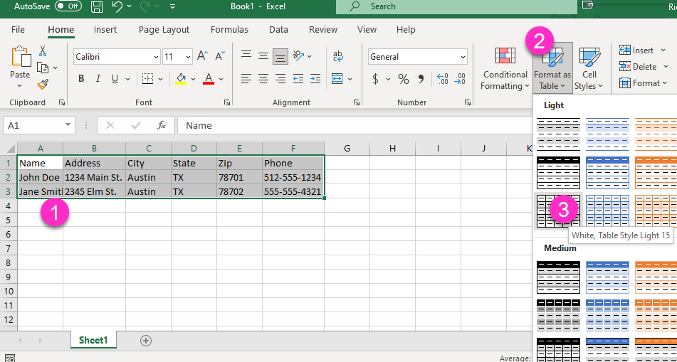
Using Excel’s Built-In Table Header – Slide 2 of 4
Notes:
Step 1, select table.
Step 2 Select Format as Table from top ribbon on home tab
Step 3 Select table style

Slide 15
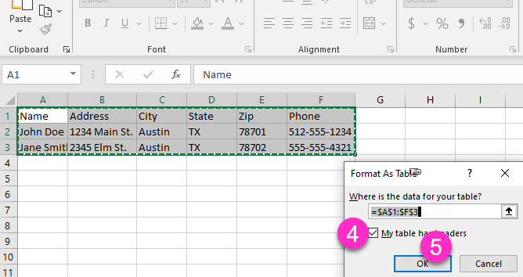
Using Excel’s Built-In Table Header – Slide 3 of 4
Notes:
Step 4 make sure checkbox is checked for My table has headers.
Step 5 select OK button

Slide 16
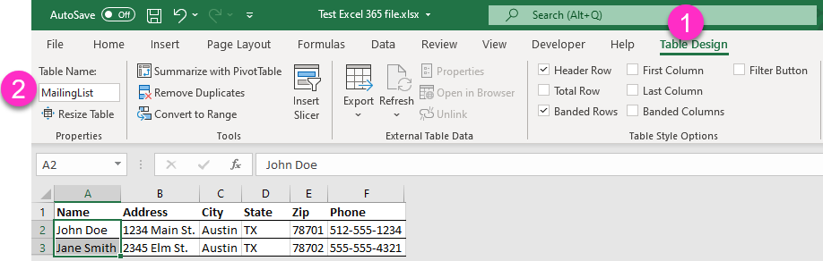
Using Excel’s Built-In Table Header – Slide 4 of 4
If you choose this method, give tables unique names
Notes:
Step 6 Give Tables unique names. Cannot have spaces. Use CamelCase

Slide 17
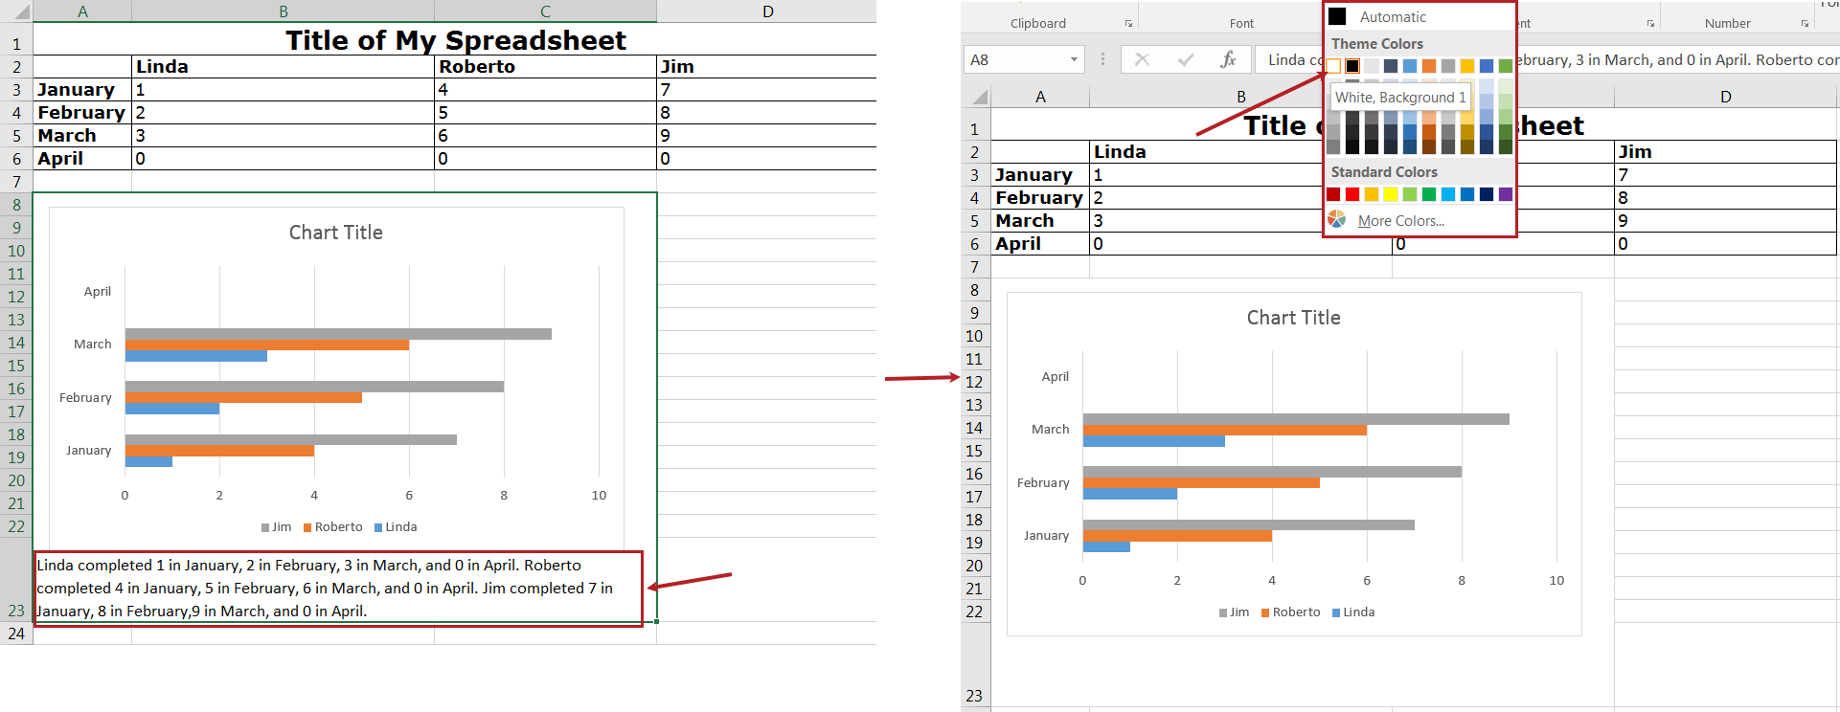
7. Alternative Text
Notes:
Ensure that any images have alternate text descriptions. Follow the steps below, or use the method for charts that we’ll discuss next. You can use the same method for alt text of images as in other MS Office programs. Right click, choose Size and Properties, then choose the Alt Text tab. If you are using MS Office 365, you can reach the alt text field on just a right click. Type in a brief description with enough detail to explain the pictures. You don’t need to say “image of” or “picture of” because the screen reader alerts the reader that it is an image. Pretend you are briefly describing the picture to someone over the phone.
Charts are a bit different since charts created in Excel are in a layer that is not accessible by screen readers, like text boxes or Word Art. There is a place for alternative text of charts, but screen readers can’t get to it.
Resize the row where you want to insert the chart. You may merge cells if you want.
Insert the chart.
In the cell where the chart is, type the description. This description may need to be fairly long to adequately explain the chart.
Hide the text of the description by changing the text color to match the background.
Now when a screen reader comes across the cell containing this chart, it will read the text description.

Slide 18
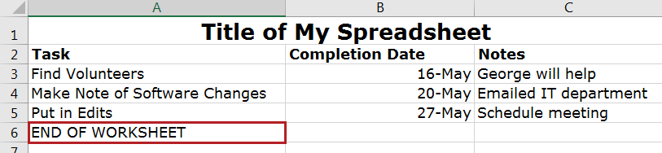
8. End of Worksheet, Workbook
Notes:
Type End of Worksheet in the row immediately after the last row of your table. If your workbook has more than one sheet, type End of Worksheet on the last row of the last sheet. The text can be white on a white background.

Slide 19
9. Before Saving
Select A1 cell on first sheet of workbook and save file unless you want users to start at a different part of the workbook when they open file
Check spelling
Set Print Area
Remove Comments
Run Accessibility Checker
Notes:
When you save a file, Excel remembers the last sheet you were working on, and the last cell selected on each sheet. So that screen readers will begin in the A1 cell on each sheet, select that cell before you save the file. Similarly, if you want users to begin at the A1 cell on the first sheet, save the file with that cell selected.
Be sure to do a spell-check on each worksheet. Excel doesn’t put a wavy red line under a word it thinks is misspelled, and it will only spell-check one worksheet at a time. In the Review tab, in the Proofing group, select Spelling, and follow the prompts.
To set the print area,
Highlight the entire area of the worksheet that includes any information
In the Ribbon, select the Page Layout tab.
In the Page Setup group, under Print Area, select Set Print Area.
Screen readers can’t read comments, so if the information is important to your audience, put it in a cell. To remove a comment, select the cell containing the comment. Right-click, and choose Delete Comment.

Slide 20
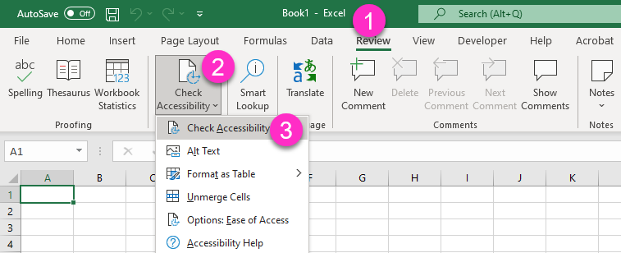
More on Accessibility Checker, Slide 1
Accessed through the Review tab

Slide 21
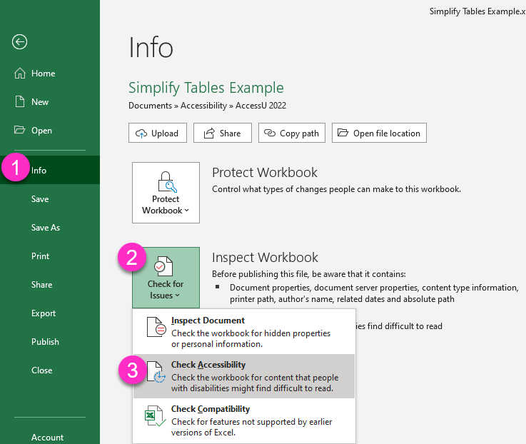
More on Accessibility Checker – Slide 2
Alternate way to reach accessibility checker

Slide 22
More on Accessibility Checker, Slide 3
Will not flag lack of content in A1
Will not flag tables that are not defined, missing row/column headers
Will flag default sheet names, but doesn’t flag undescriptive sheet names
Will flag missing alt text for images, but cannot evaluate quality of alt text
Will flag cell text with low contrast, but does not test charts, graphs and images

Slide 23
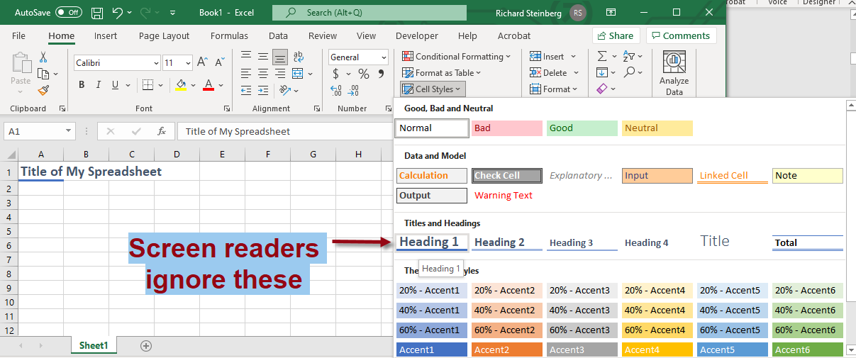
Excel Deficiencies – Slide 1
Formatting text using heading styles ignored by screen readers
Notes:
When opening a MS Word file, screen reader users rely on headings to navigate. MS Word solves this by having heading styles. Excel has heading styles too but these are ignored by screen readers. As a result there isn’t a way to code headings in Excel

Slide 24
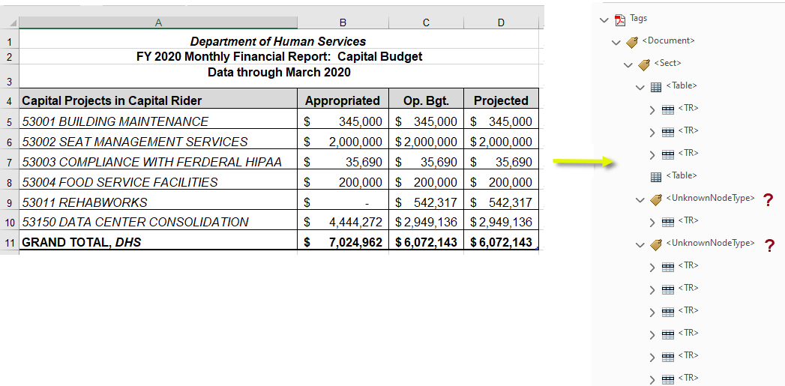
Excel Deficiencies – Slide 2
Converting Excel to accessible PDF is near impossible

Slide 25
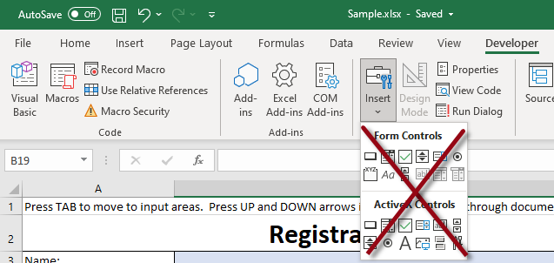
Excel Forms, Step 1
Form fields cannot be used because they lay on top of the surface of the spreadsheet and can’t be reached by screen reader
Notes:
Form fields cannot be used because they lay on top of the surface of the spreadsheet and can’t be reached by a screen reader

Slide 26
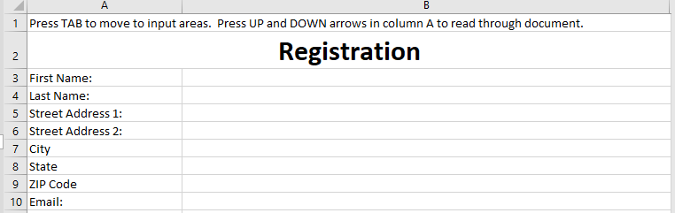
Excel Forms, Basic Design
Designing Forms
Notes:
To make an Excel form accessible, we focus on Allowing the end user to navigate using the keyboard and Providing helpful instructions that are accessible to visually impaired users who employ assistive technology screen readers. The form fields under the Developer tab cannot be used
When you design your form, set it up with descriptive fields and fill-in-the-blank fields, with layout and formatting that is easy for the user to see and understand.
And Remember that the cell that tells how to fill out a form (such as the words, “Street Address”) must be in a separate cell, next to the cell where the users will type in their address.
Some of the steps I covered in the spreadsheet section apply to forms as well.
Provide clear, meaningful titles.
Add Help Text in the First Cell, A1.
Name worksheet tabs and delete unused tabs.
Avoid empty rows, columns, and cells.
Label the end of your form.
Set the print area.
Hide unused cells.
Delete or hide unused worksheets.

Slide 27
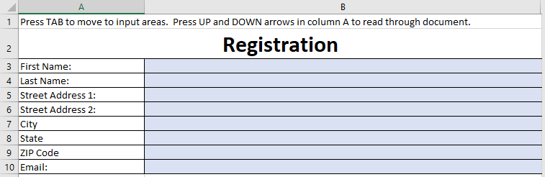
Excel Forms, Design Enhancements
Shade Input Cells and Add Border Lines for Visual Effect
Notes:
Shading the input fields helps the end user by making it easier for people to find them if they are using a mouse and when entering information.
Move the cursor to one of your input fields.
In the Home tab of the ribbon, find the Font group and select the small arrow next to the Fill Color button, which has a bucket icon. A Theme Colors sub-menu gallery appears.
Choose a color for the background shading of that cell. Choose a light color, since darker background colors make text in the fields harder to read.
Add border lines to cells for low vision users and for visual effect.

Slide 28
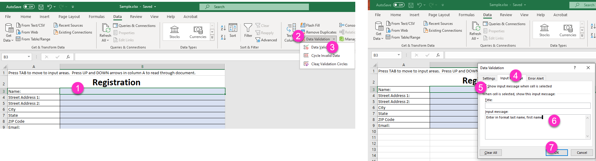
Excel Forms, Data Validation
Notes:
Data Validation contains many tools that will help create useful forms. Data validation will help to:
Provide input messages about your form fields.
Create dropdown lists of possible entries.
Prevent the wrong kind of data from being entered.
Let’s say you have a field called Name, but you specifically want the person filling out the form to input the data as Last Name, First Name. You can include those instructions in an input message. Here’s how:
Select the cell where the user inputs the data.
In the Ribbon, go to the Data tab. In the Data Tools group, click on the Data Validation tool.
Select Data Validation again.
In the Data Validation dialog box, click on the Input Message tab.
Ignore the Title field. Type your instructional text into the Input Message field.
Be sure that the Show input message when cell is selected checkbox is checked.
Select OK

Slide 29
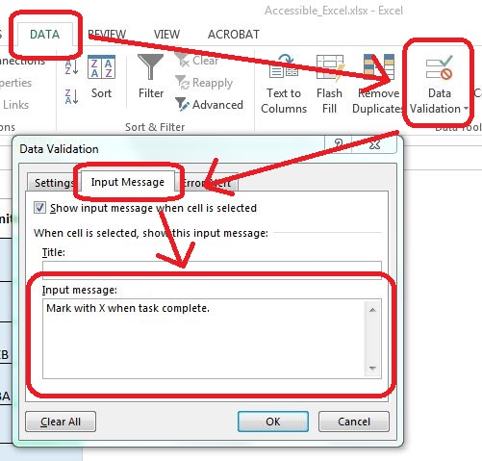
Excel Forms, Data Validation Example 2
Notes:
In this example, the form was designed with square shaped input fields where users are supposed to type an X.`

Slide 30
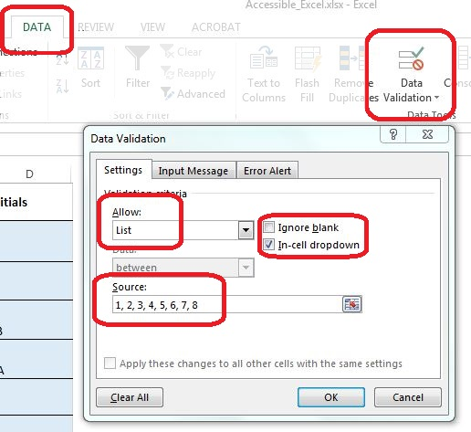
Excel Forms, Creating Drop Down Lists, Part 1
Notes:
You can create a dropdown list for filling out a form field. The user can only select options on that list.
Select the cell in your form where the user will input the information.
In the Data tab, go to the Data Tools group. In the group, choose the Data Validation tool. The Data Validation dialog box opens.
Go to the Settings tab in the dialog. In the Allow dropdown box, choose List.
Uncheck the Ignore Blank checkbox if leaving the field blank is not acceptable. Check the In-cell dropdown checkbox.
In the Source field, type in the first value, followed by a comma and space, and then type the next value.
Continue until the last value is added. Don’t add commas or spaces after the last value.
Click OK to close the Data Validation dialog box.
Now test the dropdown box.
Select the cell. You should see the dropdown arrow to the right of the cell. Click that arrow and try choosing a value.
To open a dropdown list using your keyboard, press Alt+Down Arrow to open the dropdown. Choose a value using the Arrow keys, and then press the Enter key to select it.

Slide 31
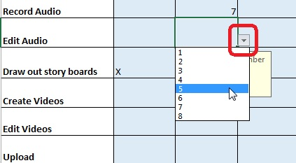
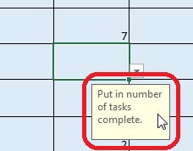
Excel Forms, Creating Drop Down Lists, Part 2
Notes:
Don’t forget to add instructions that explain how to use the list, including keyboard access. Add instructions as explained above, using the Data Validation Input Message.

Slide 32

Tips for All MS Office
Notes:
What follows are some tips that apply to all the MS Office programs.

Slide 33
Using MS Office 365 Accessibility Checker
Notes:
Each MS Office 365 program has an Accessibility Checker that you can use to check your file if your document was created using Office 365. If your document was created with a different version of Office, you can save the file in Office 365format, then check it. To get to it, select Review -> Check Accessibility
The results of the checker will be listed as Errors and Warnings in the right hand part of your screen. As you address/fix each issue, the errors and warnings go away

Slide 34
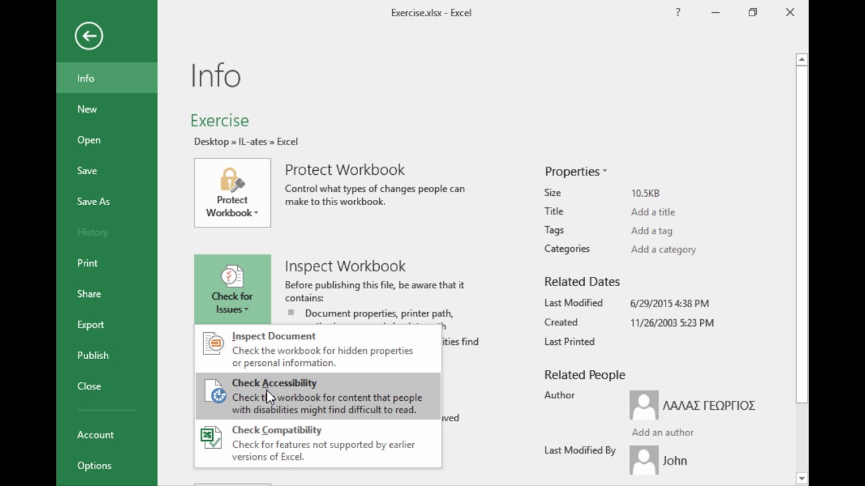
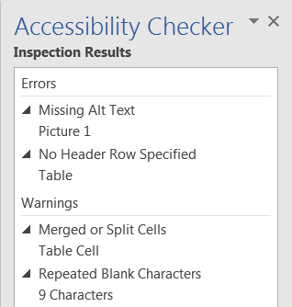
Using MS Office 2016 Accessibility Checker
Notes:
Each MS Office 2016 program has an Accessibility Checker that you can use to check your file if your document was created using Office 2016. If your document was created with a different version of Office, you can save the file in Office 2016 format, then check it. To get to it, select File -> Check for Issues -> Check Accessibility
The results of the checker will be listed as Errors and Warnings in the right-hand part of your screen. As you address/fix each issue, the errors and warnings go away

Slide 35
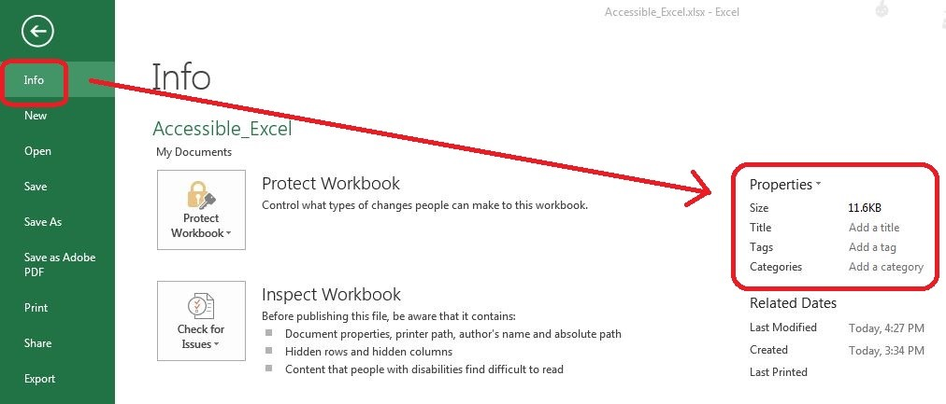
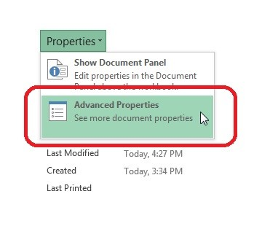
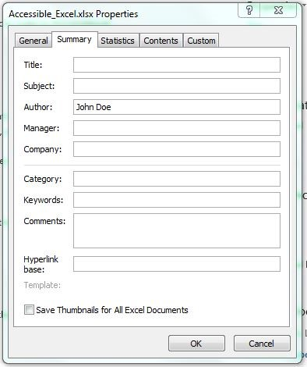
Document Properties
Notes:
Fill out the Document Properties following your organization’s standards. This provides background information on the file for those reviewing it later and assists search facilities on web sites or other document repositories. Take care to note information that should be omitted for security or privacy reasons, as well as information that should be included.
Click the File tab and choose the Info tab on the left. On the right side there is a frame listing the properties.
You may edit the properties directly here or use the drop-down menu by the Properties. Select Advanced Properties.
Select the Summary tab and enter the information in the form.

Slide 36
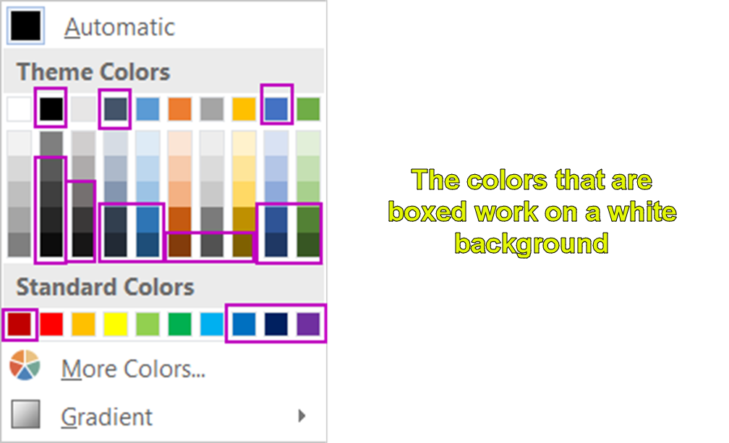
Colors that work on white
Notes:
You can use the next two charts as a quick reference. Before I picked the color purple for the boxes, I made sure that it passed the color contrast checking tool I have. You can check contrast with a free tool I will describe in a little bit.

Slide 37
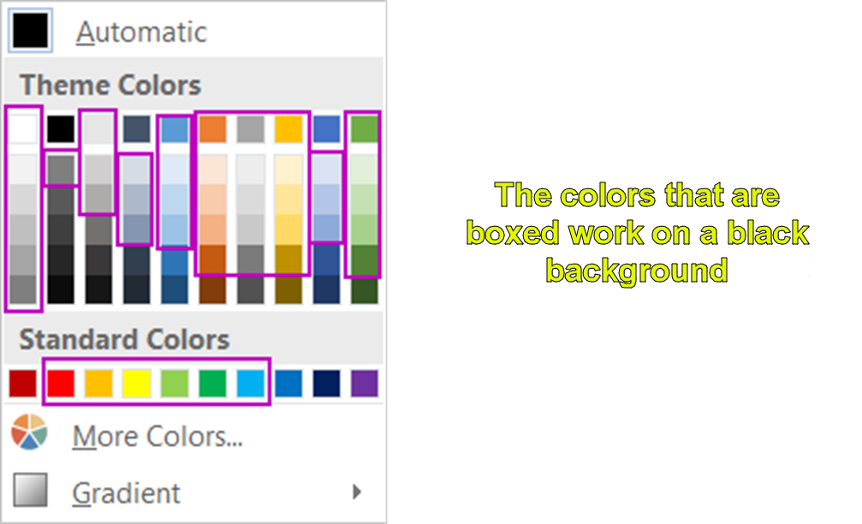
Colors that work on black

Slide 38
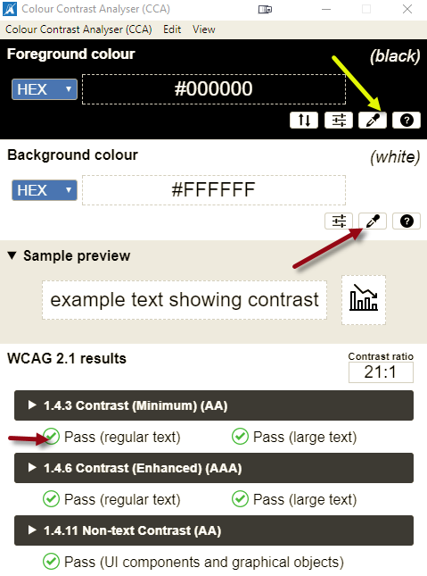
Colour Contrast Analyser
https://www.tpgi.com/color-contrast-checker/
Notes:
The Color Contrast Analyzer is a free program on The Paciello Group’s website. It’s available for Windows and Mac

Slide 39
Questions?
???

Slide 40
Thank you

